Slide 1

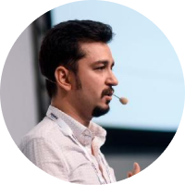

Building a Kubernetes Integrated Local Development Environment
for ASP.NET Core
Halil İbrahim Kalkan
Co-founder of

Slide 2

Agenda
The Problem: Difficulties of building a microservice solution development environment
Primitive solutions
Introducing the Kubernetes Tunneling solution
Existing products
How we’ve designed & implemented it
The tools used
Demo
Halil İbrahim Kalkan

Slide 3
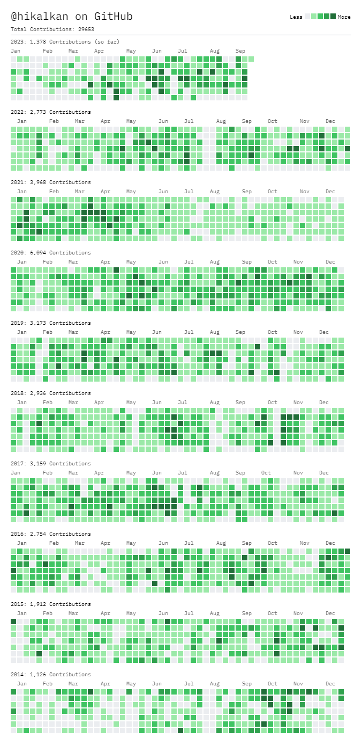






About Me
2007, Computer Engineering
2007 - 2015: Software developer, software architect, team leader
2016 - ∞: Co-founder, software architect
2013 - ∞: Lead developer of the open source ABP Framework
Multi-threading, distributed systems, OOP, DDD, software architectures.. etc.
Highly active coder, mostly open source.
Halil İbrahim Kalkan

Slide 4
Questions..?
Anyone worked in a microservice solution?
Anyone used Kubernetes?
DevOps engineers?
Backend developers?
.NET Developers?
Halil İbrahim Kalkan

Slide 5

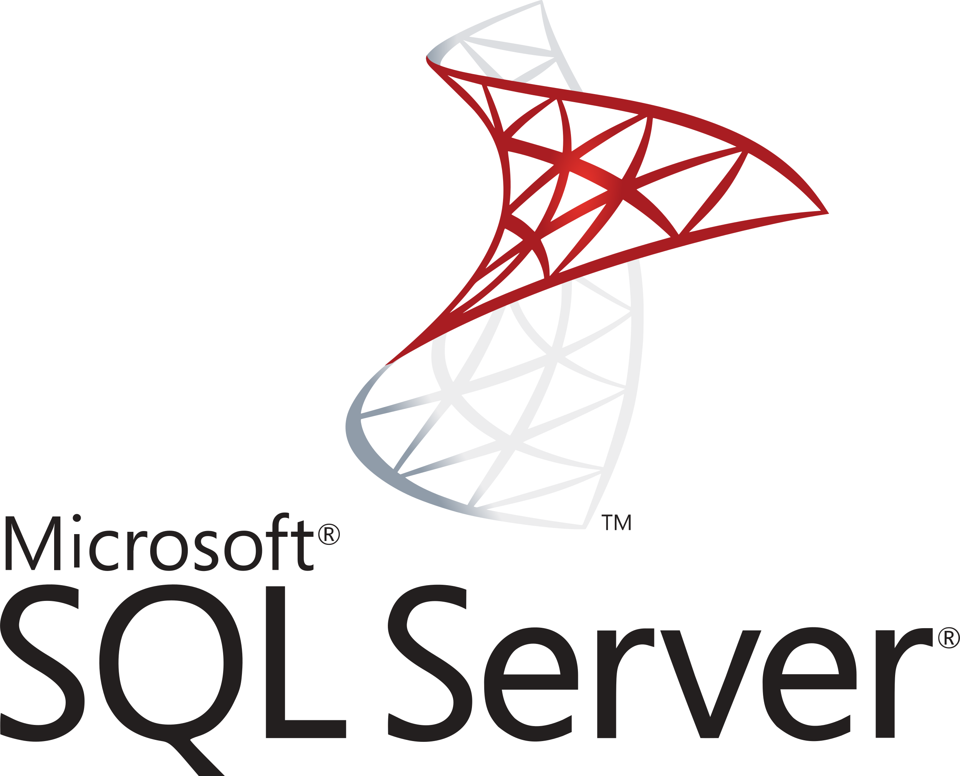





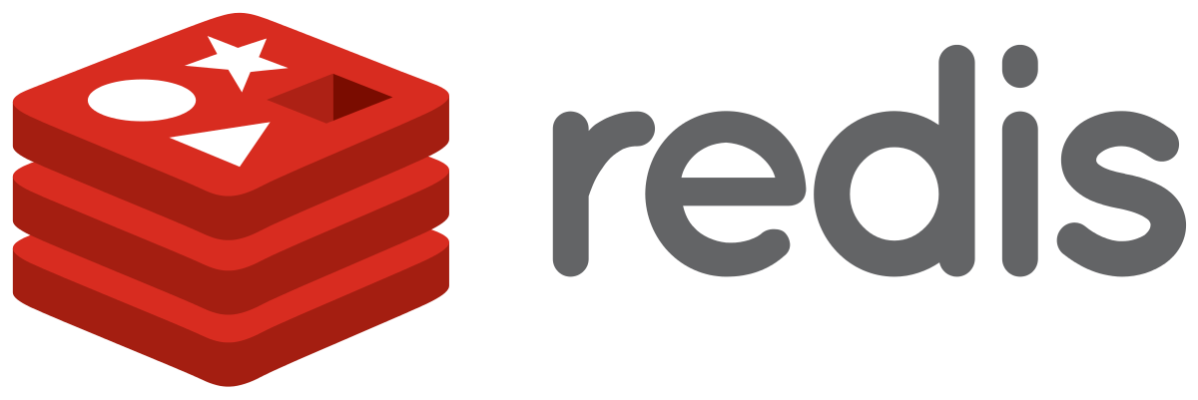


Components of a microservice solution
Authentication Server
Product
Microservice
Backend Admin Application (SPA)
Backend App
API Gateway
Ordering
Microservice
Event Bus
Public Web Site
(MVC)
Public Web Site
API Gateway
Identity
Microservice
RabbitMQ
(Distributed Cache)
(Log Database)
(Data Visualization)
Halil İbrahim Kalkan

Slide 6
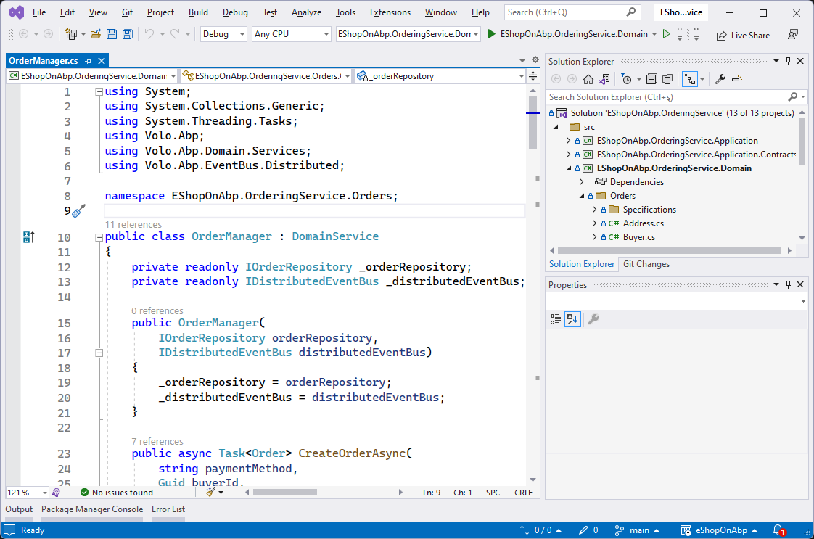
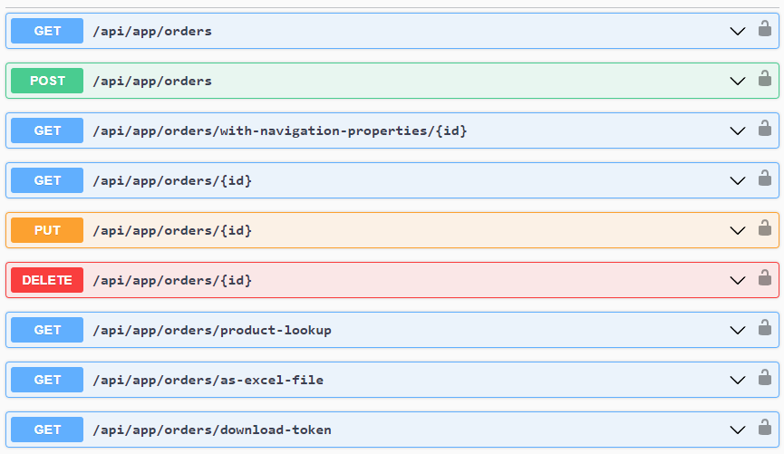
How to run a single service locally?
LOCAL DEVELOPER MACHINE
DEPENDENCIES
PRODUCT SERVICE
Authentication Server
How to make all these running easily...?
Ordering Microservice
Customer Microservice
Saas Microservice
Identity Microservice
Run locally
...other services...
Halil İbrahim Kalkan

Slide 7
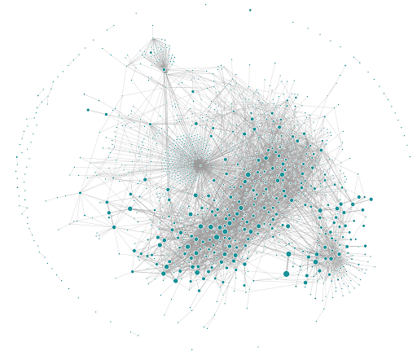
Uber’s Microservice Graph
https://www.uber.com/en-TR/blog/microservice-architecture/
Halil İbrahim Kalkan

Slide 8
Microservices unit testing
Mocking the dependencies;
  Database
  Infrastructure: Event bus, Cache, file system, 3rd-party services, ...
  API calls to other services (REST, GraphQL, gRPC...)
  Publishing events
Triggering the service
  Receiving events (typically sent by other services)
  Receiving API calls (REST, GraphQL, gRPC...) from UI and other services
Simulating network delays, errors, re-tries, distributed transactions
Halil İbrahim Kalkan

Slide 9
Primitive Solutions
Running all in local computer?
Manual run (in your IDE)
Create a Bash / Powershell script
Halil İbrahim Kalkan

Slide 10
Microsoft’s solutions
The Tye project (was experimental, now retired)
.NET Aspire
Halil İbrahim Kalkan

Slide 11
Microsoft .NET Aspire
.NET Aspire is an opinionated, cloud ready stack for building observable, production ready, distributed applications
Orchestration: Running and connecting multi-project applications and their dependencies for local development environments
Components: NuGet packages for commonly used services, such as Redis or Postgres
Tooling: Project templates and tooling experiences for Visual Studio and the dotnet CLI
Halil İbrahim Kalkan

Slide 12
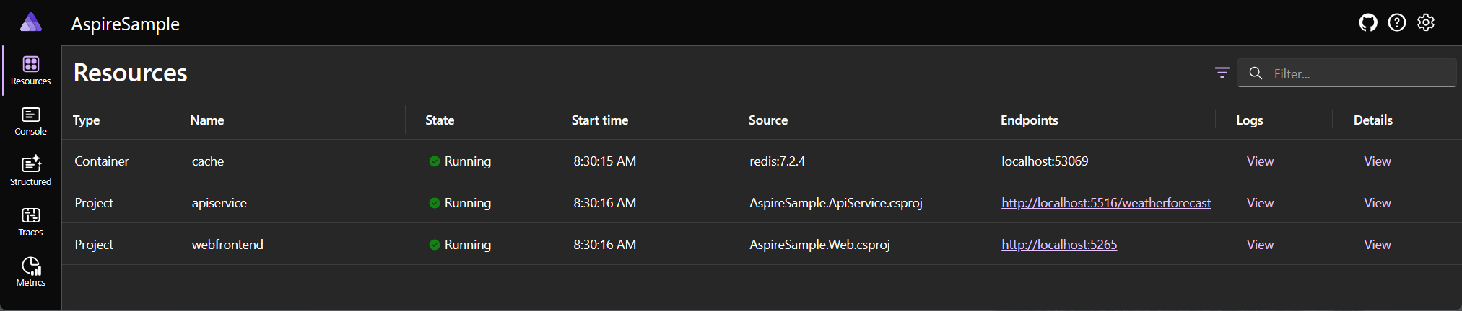
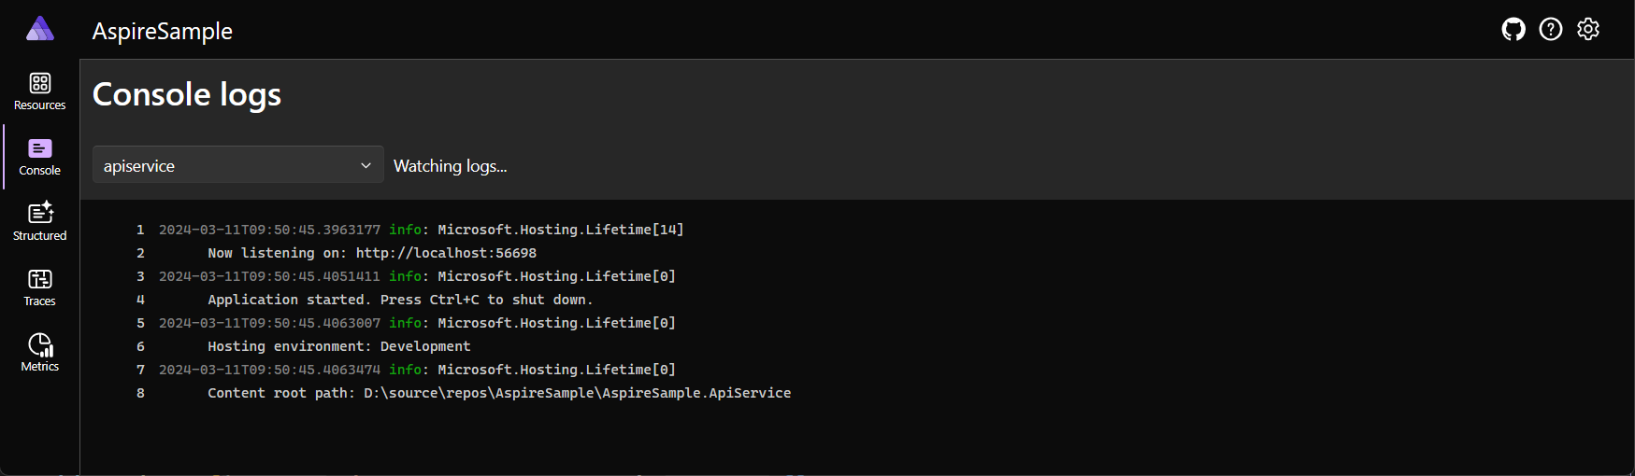
Microsoft .NET Aspire: Dashboard
Halil İbrahim Kalkan

Slide 13
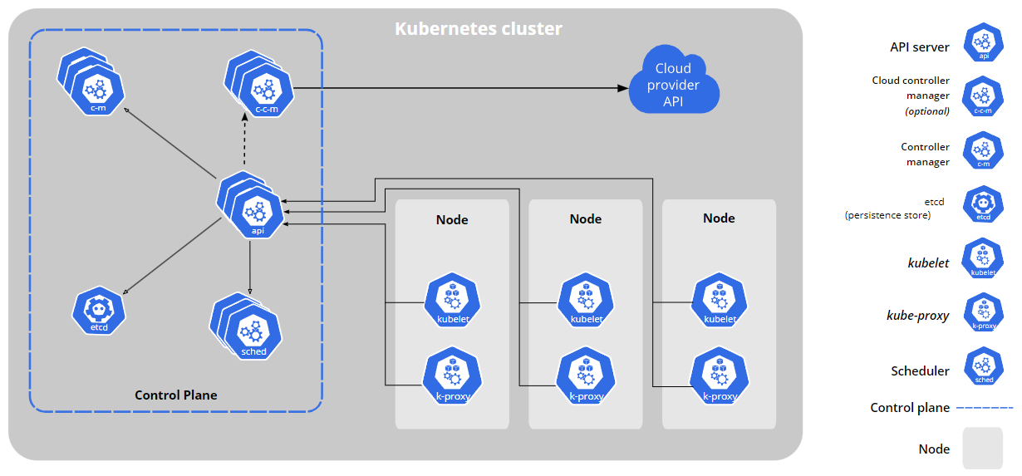
Kubernetes: What is it?
An open-source system for automating deployment, scaling, and management of containerized applications.
Halil İbrahim Kalkan

Slide 14
Kubernetes: How can it help us?
Run the solution in a Kubernetes cluster
(all applications, services, gateways, infrastructure)
Run the Product Service in your local computer, in your favorute IDE
Connect two environments together!
HOW..?
Halil İbrahim Kalkan

Slide 15
Kubernetes – Local computer connection/integration
LOCAL DEVELOPER MACHINE
KUBERNETES CLUSTER
PRODUCT SERVICE
Authentication Server
Use infrastructure (DB, Redis, etc)
Ordering Microservice
Use other services / applications
(including in-cluster services)
Customer Microservice
Use configuration / environment
variables
Saas Microservice
Identity Microservice
Run locally
...other services...
Use the product service
(REST API calls, events, etc)
Halil İbrahim Kalkan

Slide 16
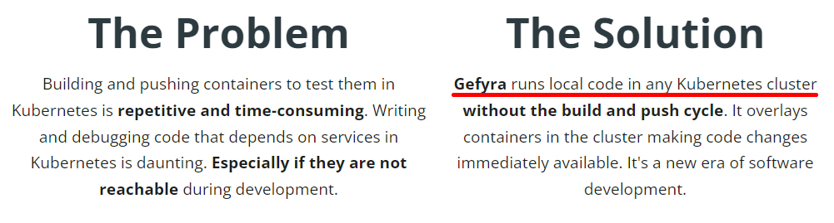
Existing solutions / products
Visual Studio Bridge to Kubernetes
https://learn.microsoft.com/en-us/visualstudio/bridge
https://telepresence.io
https://garden.io
https://gefyra.dev (open source & free)
Halil İbrahim Kalkan

Slide 17
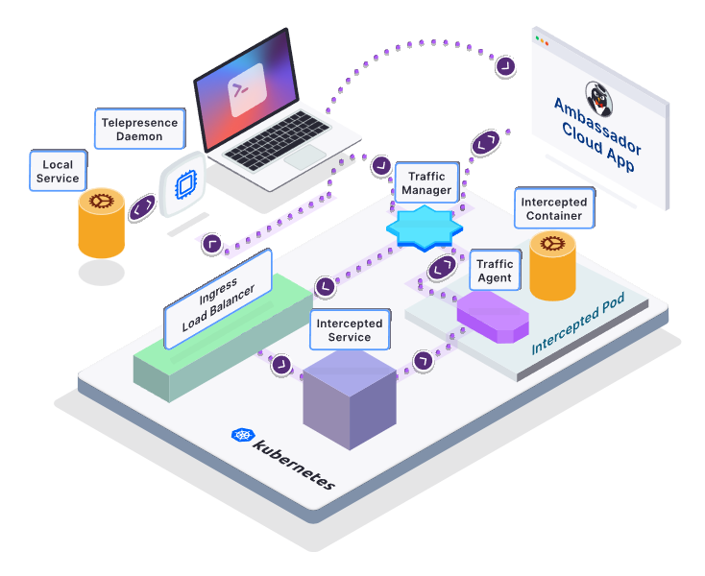
Telepresence
Set up remote development environments for Kubernetes where you can still use all of your favorite local tools like IDEs, debuggers, and profilers.
Halil İbrahim Kalkan

Slide 18
Telepresence: How it works
Install the Telepresence CLI to your local computer
Install Telepresence in your Kubernetes cluster
$ telepresence helm install
Connect to your Kubernetes cluster
$ telepresence connect
Intercept your service
$ telepresence intercept <service-name> --port <local-port>[:<remote-port>] --env-file <path-to-env-file>
Start your local environment using the environment variables retrieved in the previous step
Halil İbrahim Kalkan

Slide 19


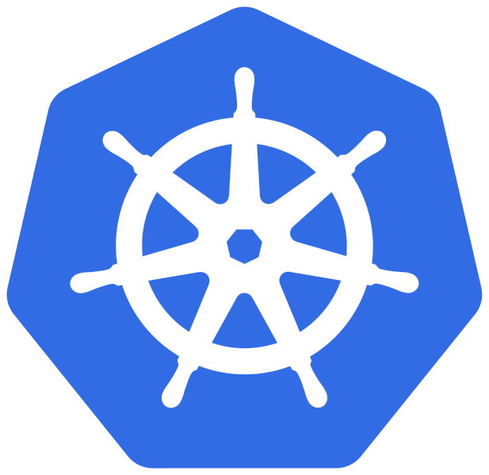
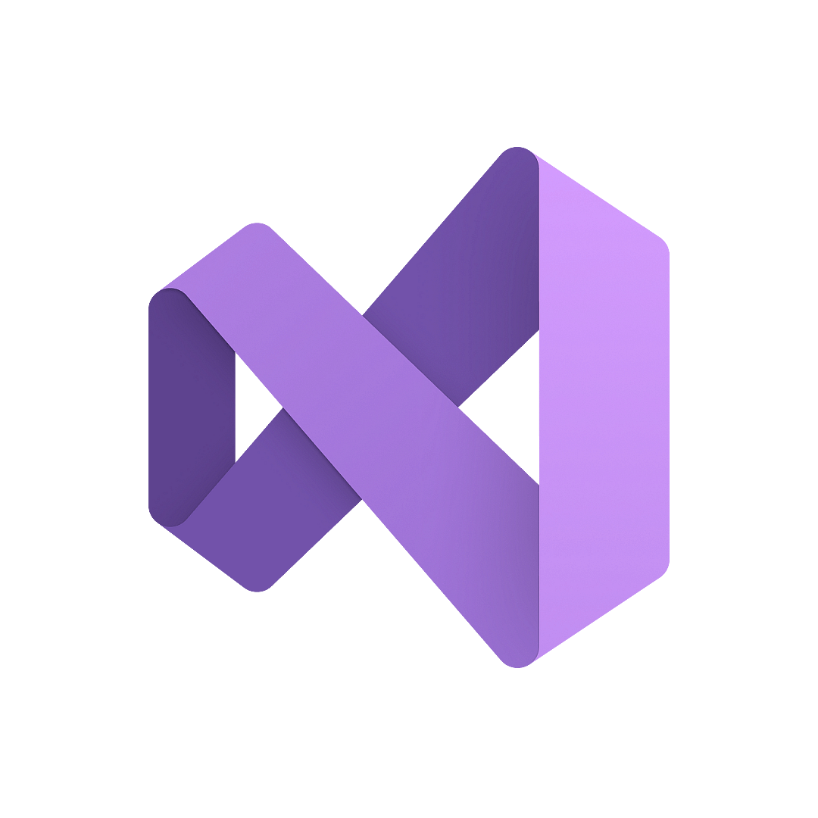
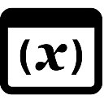



How did we implement it?
Browser (user)
Local Developer Machine
Local Product
microservice instance
(in Visual Studio)
<----- VPN TUNNEL ----->
Ingress
Kubernetes Cluster
Environment variables
Web Application
Product
Interception Proxy Server
Product Interception Client
API Gateway
ABP STUDIO
Product
microservice
Ordering
microservice
Identity
microservice
hosts file
RabbitMQ
VPN Client
VPN Server
access internal services...
ABP Proxy Client
ABP Studio Client Proxy Server
Halil İbrahim Kalkan

Slide 20
Implementation: The Operations
Connect
Establish a VPN Tunnel
Access to cluster services
Start to collect the monitoring data
Intercept
Setup a proxy server-client & redirect the traffic to local machine
Override environment variables
Add DNS records to hosts file
Halil İbrahim Kalkan

Slide 21

Implementation: The Tools
frp
https://github.com/fatedier/frp
frp is a fast reverse proxy that allows you to expose a local server located behind a NAT or firewall to the Internet.
It currently supports TCP and UDP, as well as HTTP and HTTPS protocols, enabling requests to be forwarded to internal services via domain name.
https://www.wireguard.com
WireGuard® is an extremely simple yet fast and modern VPN that utilizes state-of-the-art cryptography.
It aims to be faster, simpler, leaner, and more useful than IPsec, while avoiding the massive headache.
Halil İbrahim Kalkan

Slide 22
See it in action!
DEMO
Halil İbrahim Kalkan

Slide 23
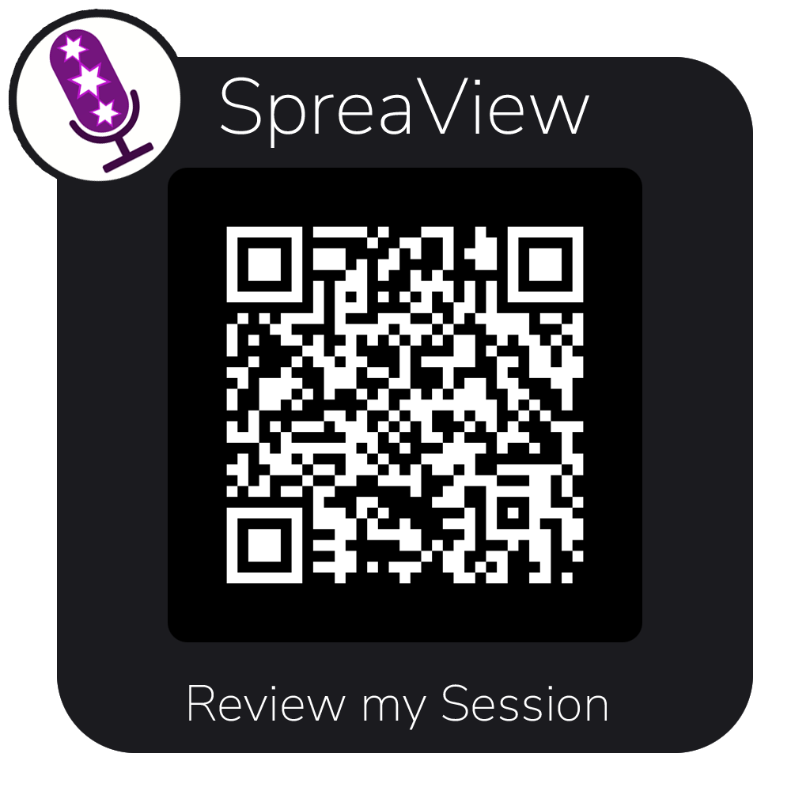

Slide 24
Thanks for listening..!
Halil İbrahim Kalkan
Co-founder of
Web: https://halilibrahimkalkan.com
GitHub: hikalkan
Twitter: hibrahimkalkan
ABP Framework: https://abp.io
This Presentation: https://github.com/hikalkan/presentations
Halil İbrahim Kalkan

